Slide 1
Afghan Perspectives
Syed Muzaffar
Shuja Mohabathzath

Slide 2
Training Objectives
1. UNDERSTANDING THE OPERATIONAL ENVIRONMENT
Enabling objectives:
1.1 Understanding the human populations in the operational environment as defined and characterized by sociocultural, anthropological, ethnographical data and non-geographical information.

Slide 3
Training Objective
2. UNDERSTANDING THE ANSF
Enabling objectives:
2.4 Understand Governance in Afghanistan and the relationship with the power holders.
7. PERFORM WITHIN ASSIGNMENT
Enabling objectives:
7.11 Understand how to address corruption

Slide 4
Afghan Perspectives
Agenda:
Outlook of Afghan Economy
National Unity Government (NUG)
Culture of Corruption
Security Transition

Slide 5
Afghans Perspective on Economy

Slide 6
Afghan GDP
Afghanistan GDP:
$38.4 billion (2014 est.)
$45.3 billion (2013 est.) $34.25 billion (2012 est.) $30.45 billion (2011 est.)
GDP - per capita:
$1,100 (2013 est.) $1,100 (2012 est.) $1,000 (2011 est.)
Afghan revenue: 3.1 Billion Est.
Afghan budget 12 billions Est. (including ANSF)

Slide 7
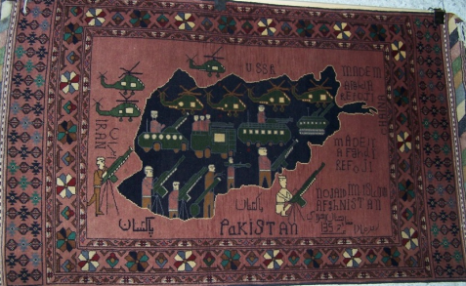
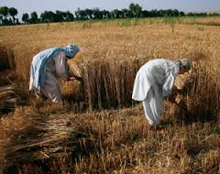
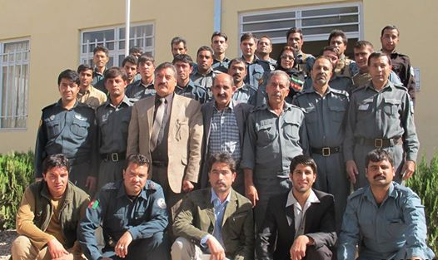
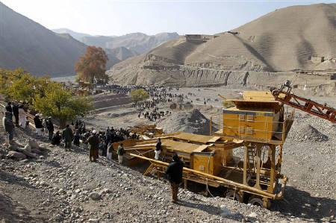
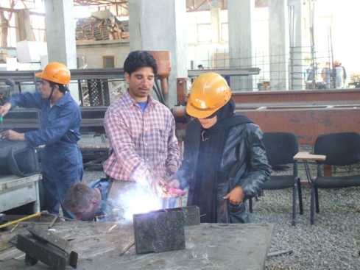
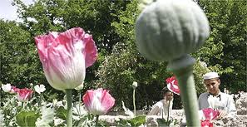
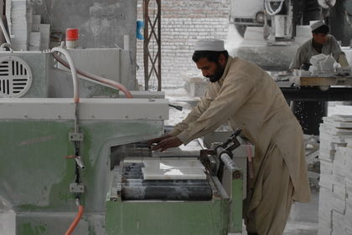
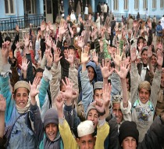
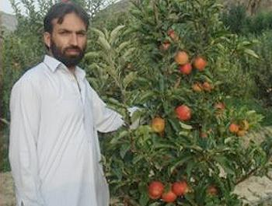
What makes the Afghan Economy?
20% of GDP
25.6% of GDP
54.4% GDP
Agriculture
Mines &Industries
Services

Slide 8
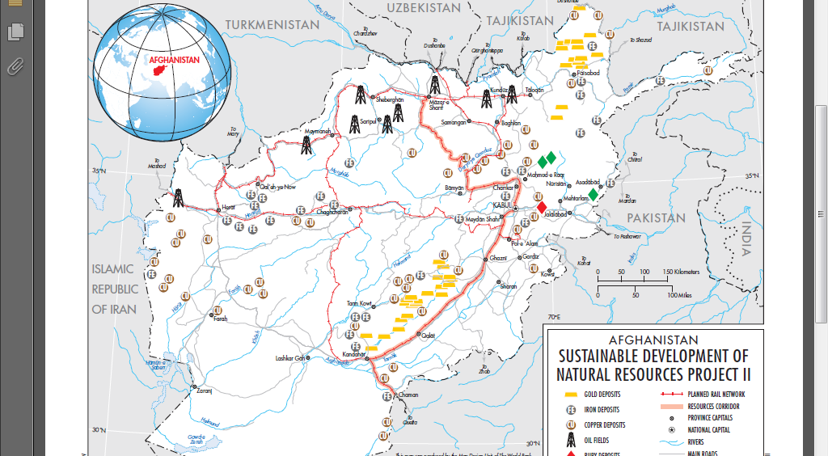
Afghanistan Natural Resources

Slide 9
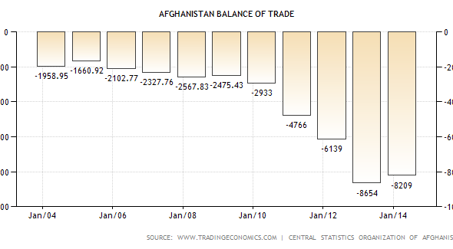
Afghanistan Balance of Trade

Slide 10
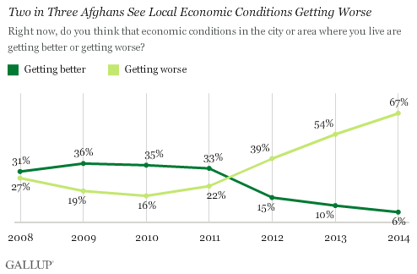
Afghan Economic Condition

Slide 11
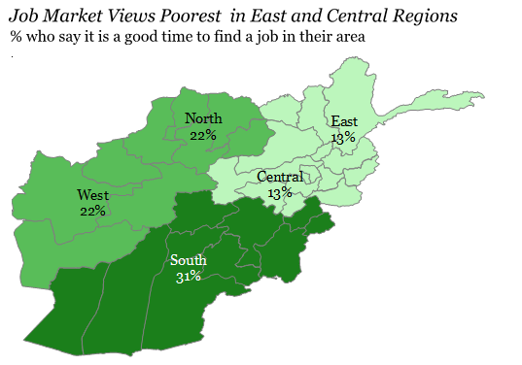
Job Market

Slide 12
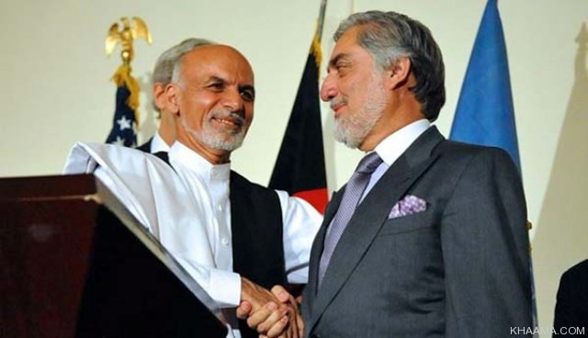
Afghan Perspectives on NUG

Slide 13
Afghan Perspectives on the Government
National Unity Government (NUG) overview
Share of Power (50/50)
Delay in Introducing the cabinet in time
Delay in selecting PGs
Reluctance in investments
Loss of confidence

Slide 14
Afghan Perspectives on NUG
NUG new Cabinet
People Vs Power Brokers
7 already rejected
Uncertainties
How will the Government of National Unity Work?
Appointments at the national, provincial and local levels

Slide 15
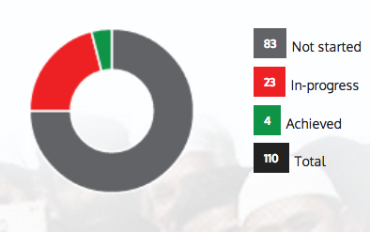
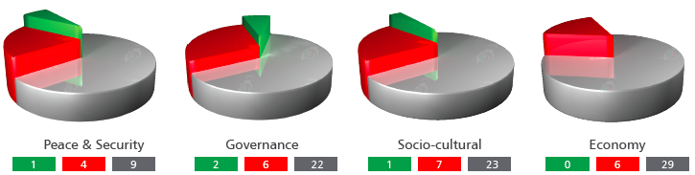
NUG Accomplishments at a glance

Slide 16



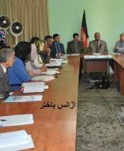

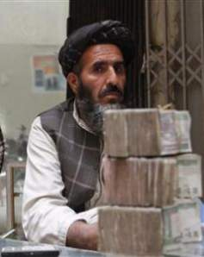
Culture of Corruption
Ignore the Game
Fight the Game
Play the Game
Notes:
Corruption and how it works
how the corruption affects the population
Corruptions issues within ANSF
Organised crimes and their network.

Slide 17
Afghan Perspectives on Security Transition
ANSF
Increased Public support
Changes in ANSF
ANSF Casualties vs Equipments
Recent arrests of Mafia leaders.
NATO (RSM)
What will be NATO’s support beyond 2016?
NUG negotiation on extending the mission.
Insurgents
Increase of violence across the country
Taking advantage of Unity Government Challenges
Increase in Foreign Fighters

Slide 18
Questions?
Shuja Mohabadzath sahmad2001@yahoo.co.uk | Syed Muzaffar smuzaffar2@gmail.com

